Slide 1
The Normal Curve, Standardization and z Scores
Chapter 6

Slide 2
Freakanomics!
Go go go!

Slide 3
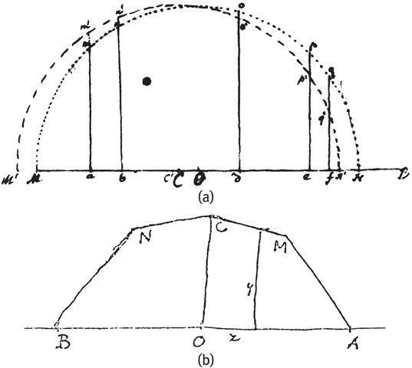
The Bell Curve is Born (1769)
De Moivre – Bernoulli – De Morgan

Slide 4
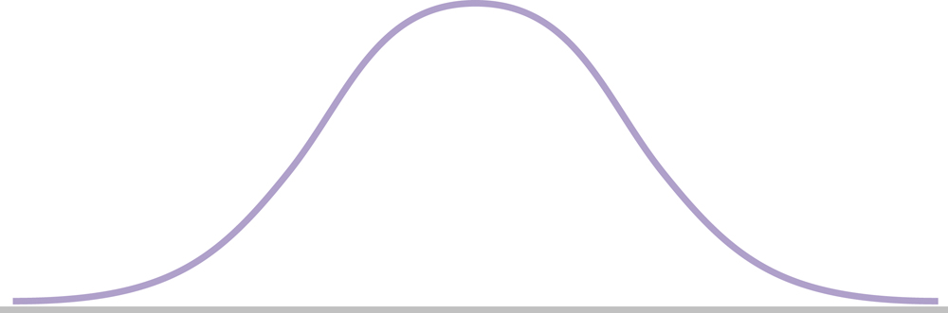
A Modern Normal Curve
Remember: unimodal, symmetric

Slide 5
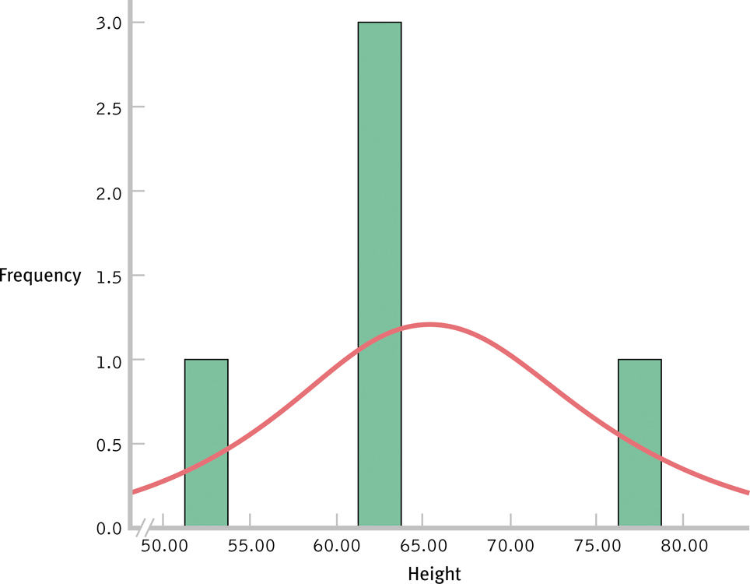
Development of a Normal Curve: Sample of 5

Slide 6
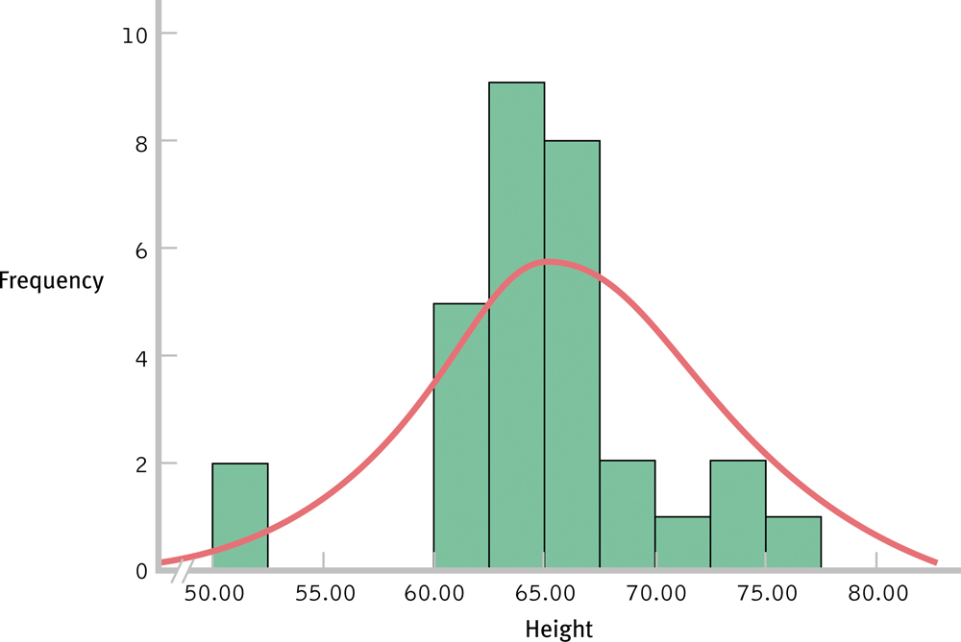
Development of a Normal Curve: Sample of 30

Slide 7
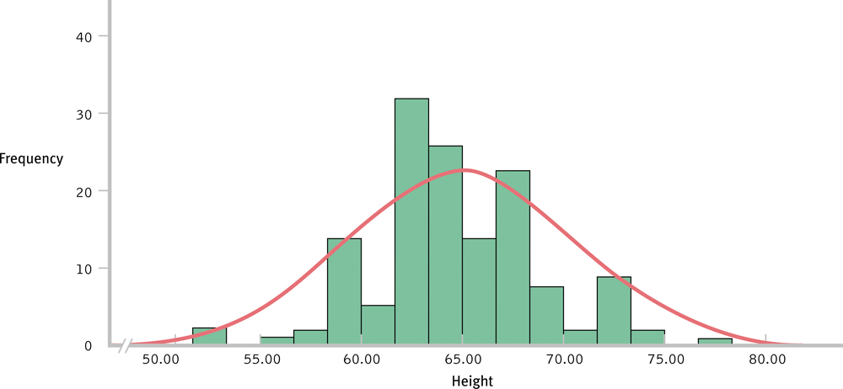
Development of a Normal Curve: Sample of 140

Slide 8
Central Limit Theorem
As the sample size increases, the shape of the distribution becomes more like the normal curve.
Can you think of variables that might be normally distributed?
Think about it: Can nominal (categorical) variables be normally distributed?

Slide 9
Standardization, z Scores, and the Normal Curve
Let’s say we wanted to compare our student scores on the old GRE (800 point scale) to the new GRE (170 point scale)
Standardization: allows comparisons by creating a common shared distribution
Also allows us to create percentiles (p-values!)

Slide 10
Standardization, z Scores, and the Normal Curve
Normal curve = standardized
z distribution (draw it)
z scores
Comparing z scores
Percentiles are p values.
Different ways to think about p.

Slide 11
Standardization, z Scores, and the Normal Curve
Z-distribution – normal distribution of standardized scores
Also called standard normal distribution

Slide 12
Standardization, z Scores, and the Normal Curve
So what are z-scores?
Number of standard deviations away from the mean of a particular score
Can be positive or negative
Positive = above mean
Negative = below mean
Tip! Make yourself a symbols chart!

Slide 13
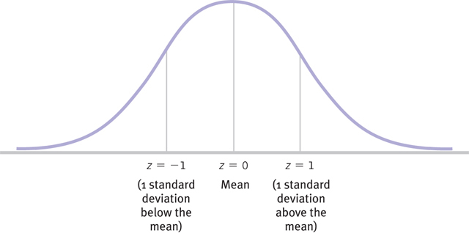
The z Distribution

Slide 14
Standardization, z Scores, and the Normal Curve
Z-distribution
Mean = 0
Standard deviation = 1

Slide 15
Examples
Be sure you can do the following:
Find a z score
Find a raw score (x)
Compare scores
Find a percent above
Find a percent below
Find a percent between
Given percent find a z
Given percent find a raw score

Slide 16
Transforming Raw Scores to z Scores
Step 1: Subtract the mean of the population from the raw score
Step 2: Divide by the standard deviation of the population
Example 1

Slide 17
Transforming z Scores into Raw Scores
Step 1: Multiply the z score by the standard deviation of the population
Step 2: Add the mean of the population to this product
Example 2

Slide 18
Using z Scores to Make Comparisons
If you know your score on an exam, and a friend’s score on an exam, you can convert to z scores to determine who did better and by how much.
z scores are standardized, so they can be compared!
Example 3

Slide 19
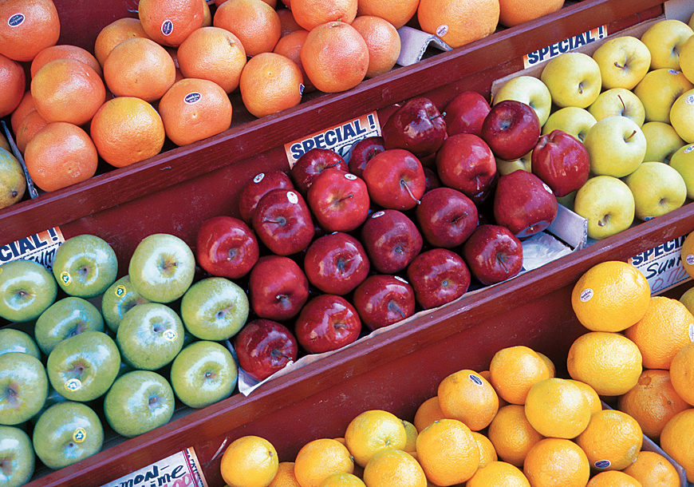
Comparing Apples and Oranges
If we can standardize the raw scores on two different scales, converting both scores to z scores, we can then compare the scores directly.
Example 3

Slide 20
Examples
Spelling bee:
Normal returning spellers: 20%
Standard deviation returning: 2.2%
2014 returning spellers: 24.8%
Converting x to z

Slide 21
Examples
Spelling bee:
Normal returning spellers: 20%
Standard deviation returning: 2.2%
2014 returning spellers: 24.8%
What would a z score of 2 be?
Convert z to x

Slide 22
Examples
Spelling bee:
Normal returning spellers: 20%
Standard deviation returning: 4%
2014 returning spellers: 24.8%
Beauty pageants
Normal returning women: 15%
Standard deviation returning: 5%
2014 returning women: 23%
Comparison of z

Slide 23
Transforming z Scores into Percentiles
z scores tell you where a value fits into a normal distribution.
Based on the normal distribution, there are rules about where scores with a z value will fall, and how it will relate to a percentile rank.
You can use the area under the normal curve to calculate percentiles for any score.

Slide 24
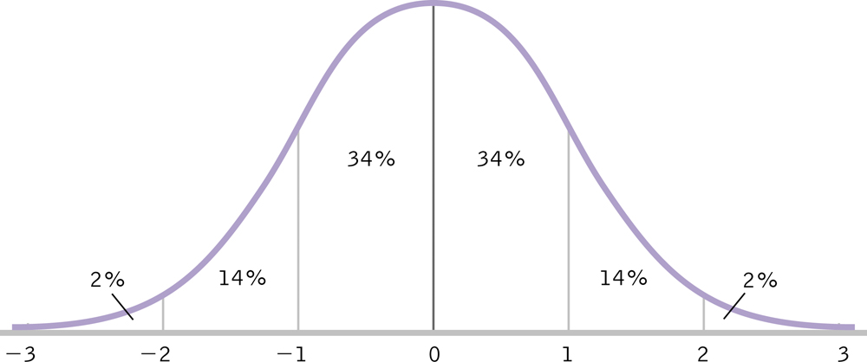
The Normal Curve and Percentages
Called the 34-14 rule

Slide 25
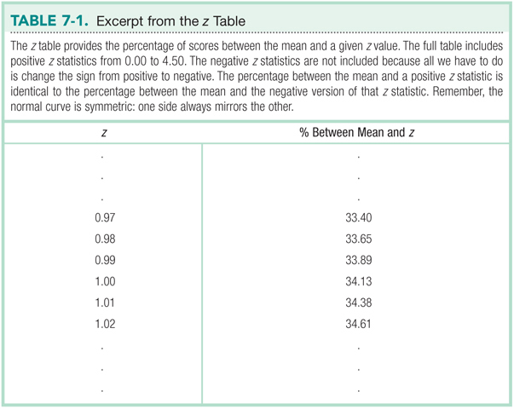

Slide 26
Remember R
Only the positive numbers are on the table
The z distribution is normal, so we don’t need the negatives (it’s symmetric).
However, tables are dumb when we have a program that will calculate for us!

Slide 27
Sketching the Normal Curve
The benefits of sketching the normal curve:
Stays clear in memory; minimizes errors
Practical reference
Condenses the information
Allows you to make sure the R information you are getting seems right.

Slide 28
R Curves
To get a p value from a z score:
pnorm(z, lower.tail = F)
lower.tail depends on what you want (options are T or F)

Slide 29
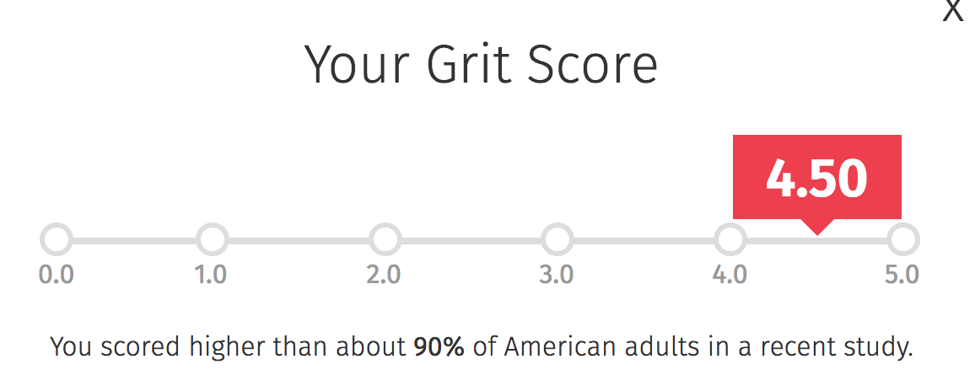
GRIT Scale
http://angeladuckworth.com/grit-scale/

Slide 30
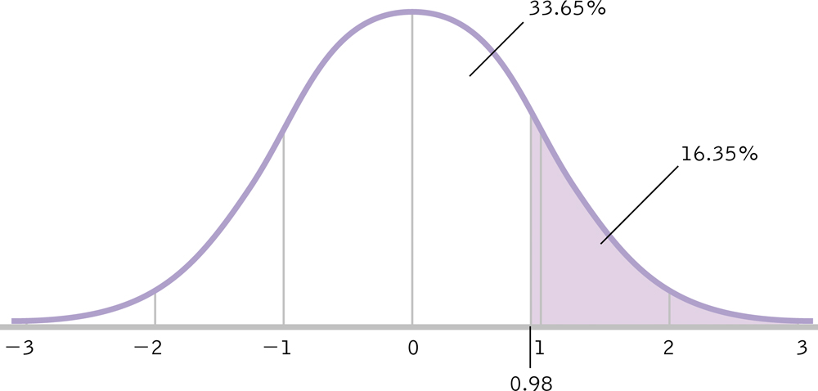
Calculating the Percentage Above a Positive z Score
Example 4

Slide 31
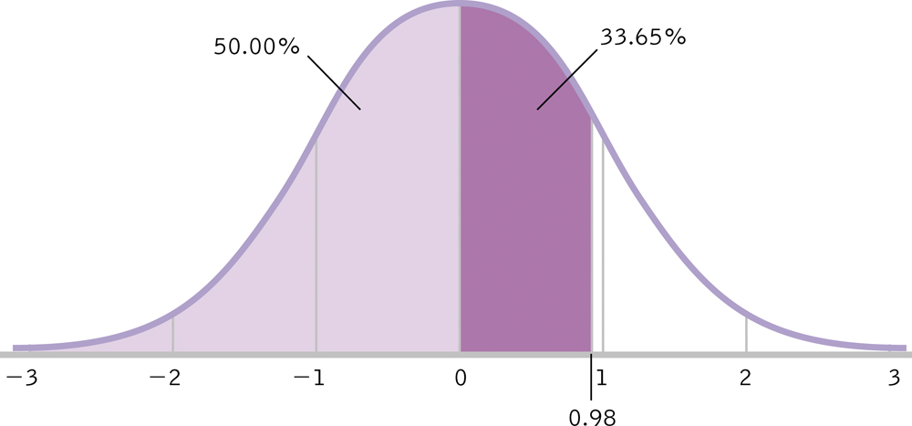
Calculating the Percentile for a Positive z Score
Example 5

Slide 32
GRIT Scale
Population mean: 3.00
Population SD: 1.75
Dr. B’s score: 4.50
Calculate the percent above Dr. B.
Calculate the percent below Dr. B.

Slide 33
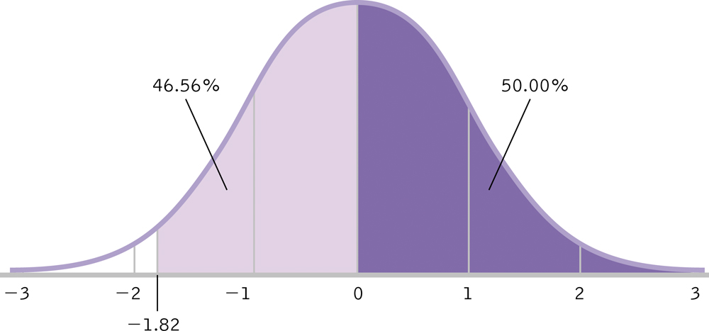
Calculating the Percentage Above a Negative z Score
Example 4

Slide 34
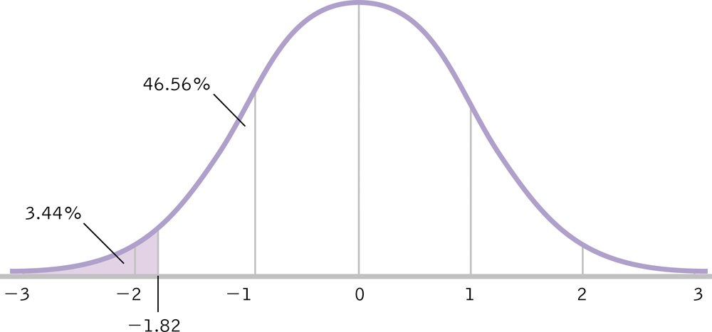
Calculating the Percentile for a Negative z Score
Example 5

Slide 35
GRIT Scale
Population mean: 3.00
Population SD: 1.75
Dr. B’s new sad face score: 2.50
Calculate the percent above Dr. B.
Calculate the percent below Dr. B.

Slide 36
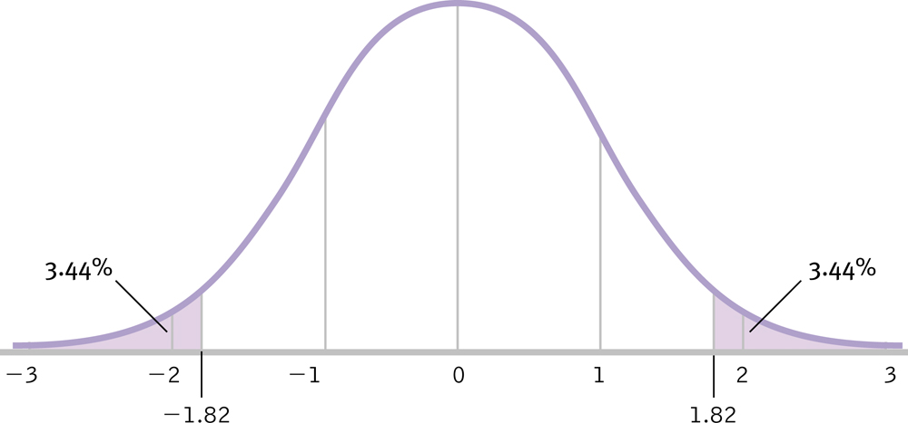
Calculating the Percentage at Least as Extreme as Our z Score
Example 6 (ish)

Slide 37
Calculating the Percentage Between Two Z Scores
What’s the percent between a z of:
-.34
And
1.02?
pnorm(-.34, lower.tail = F)
pnorm(1.02, lower.tail = F)
-.34
0
1.02
Example 6

Slide 38
GRIT Scale
Population mean: 3.00
Population SD: 1.75
Dr. B’s score: 4.50
Dr. B’s new sad face score: 2.50
Calculate the percent between her two scores.
Calculate the percent outside of her scores.

Slide 39
R Curves
To get a z score from a p value:
qnorm(p, lower.tail = F)
lower.tail depends on what you want (options are T or F)

Slide 40
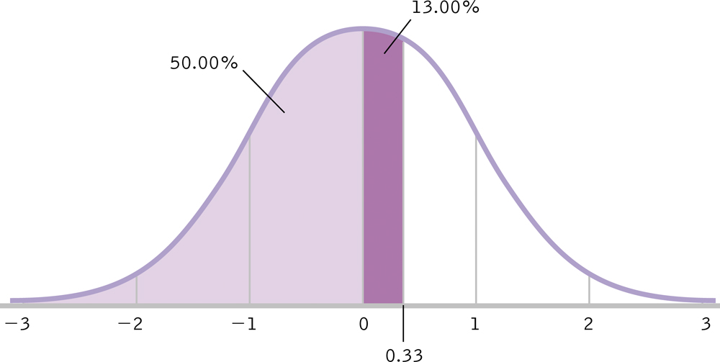
Calculating a Score from a Percentile
Example 7 and 8

Slide 41
Calculating a Score from a Percentile
Mu u = 150
SD o = 5
Top 5%
qnorm(.95, lower.tail = T) OR
qnorm(.05, lower.tail = F)
Z = 1.64
X = 1.64(5) + 150 = 158.2

Slide 42
GRIT Scale
Population mean: 3.00
Population SD: 1.75
What would the z score be if you were in the bottom 2%?
What would the raw score be if you were in the bottom 2%?

Slide 43
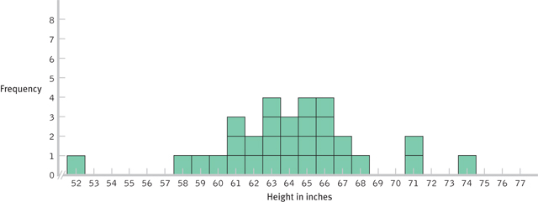
Creating a Distribution of Scores
These distributions were obtained by drawing from the same population.

Slide 44
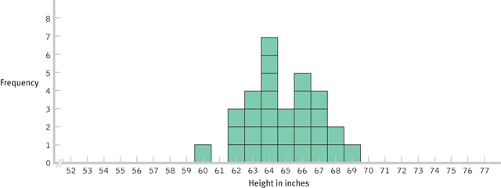
Creating a Distribution of Means

Slide 45
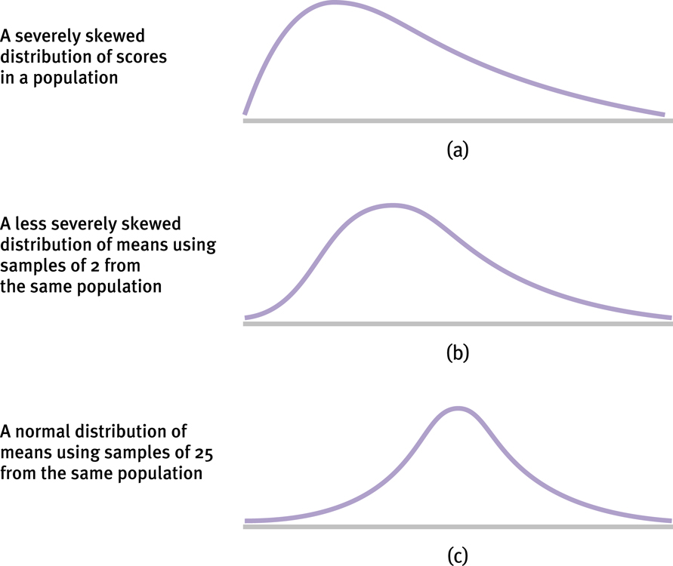
The Mathematical Magic of Large Samples

Slide 46
Distribution Bunnies!
https://youtu.be/jvoxEYmQHNM

Slide 47
The Central Limit Theorem
Distribution of sample means is normally distributed even when the population from which it was drawn is not normal!
A distribution of means is less variable than a distribution of individual scores.
(meaning SD is smaller, but we don’t call it SD)
Most of statistics is based on making beer better.
Which is why it’s awesome!

Slide 48
Distribution of Means
Mean of the distribution tends to be the mean of the population.
Standard deviation of the distribution tends to be less than the standard deviation of the population.
The standard error: standard deviation of the distribution of means

Slide 49
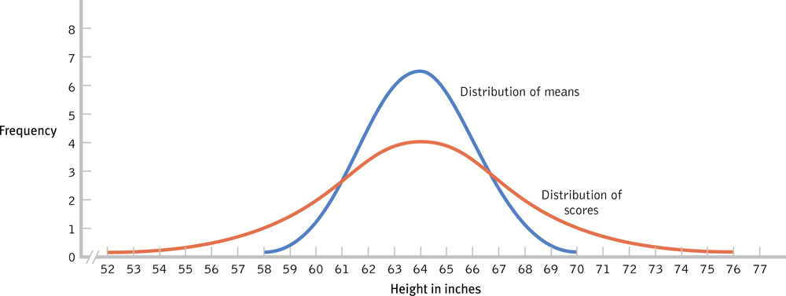
Using the Appropriate Measure of Spread

Slide 50
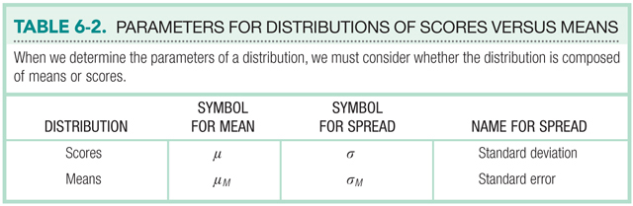

Slide 51
Z statistic for Distribution of Means
When you use a distribution of means, you tweak how you calculate z!
Calculation of percentages stays the same.
z = M – μM
σM
Means
z = X – μ
σ
Scores

Slide 52
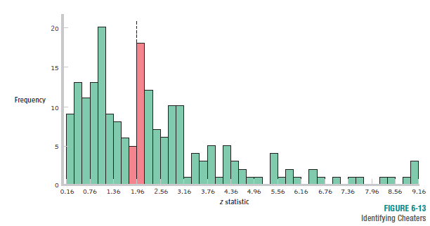
The Normal Curve and Catching Cheaters
This pattern is an indication that researchers might be manipulating their analyses to push their z statistics beyond the cutoffs.

